Slide 1
English as an
Indo-European Language

Slide 2
LANGUAGE FAMILY
Indo- European
Languages
Groups of languages are related to each other
Common ancestry
Vocabulary, phonology, morphology, and syntax
Proto-Indo- European
English
Germanic

Slide 3
COMMON ANCESTRY
Romance languages
Germanic languages
We do not have a written ancestor
Cultural and geographical contact
Latin
Proto-Germanic
French, Italian, Spanish, Portuguese, Catalan
primary factors
East Germanic
North Germanic
West Germanic
Languages exchange vocabulary
Need and prestige
Lower number of dialects
Gothic
Old Icelandic
German, Yiddish, Dutch, Flemish, Afrikaans and English

Slide 4
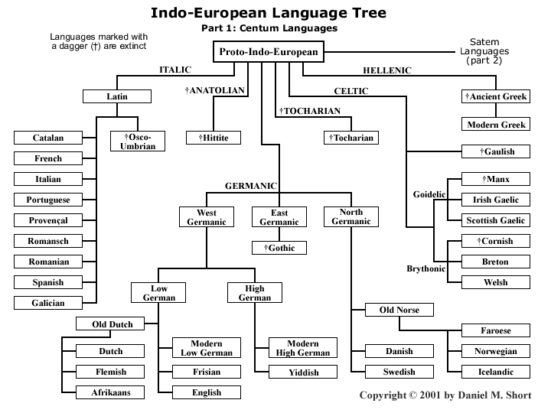

Slide 5
Extintc
Tocharian
Celtic
Germanic
Anotolian
Baltic
INDO-EUROPEAN LANGUAGE FAMILY
Indic
Indo-Iranian
Balto-Slavic
Iranian
Slavic
Greek
Hellenic
Italic
Armenian
Albanian
Attic
Faliscan
Osco-Umbrian

Slide 6
ASPECTS OF THE STRUCTURE PIE
Allow researchers to find out similarities in families language
Phonology
Morphology
Verbal Morphology
Syntax
Grammatically
Semantically
Word order
Nominal
Pronominal
2 voices (active, mediopassive
number of tenses
mood

