Slide 1
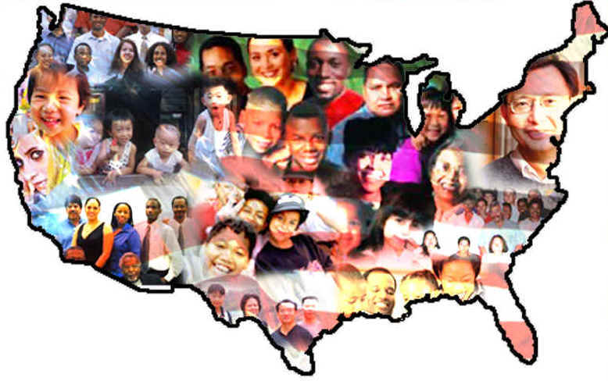
LANGUAGE, SOCIETY AND CULTURE

Slide 2
Society
SOCIOLINGUISTICS
Anthropology
Language
Sociology
Social Psychology
Social dialects
class
Variety of the language used by groups defined according
education
age
sex
Number of other social parameters

Slide 3
PRESTIGE
Overt prestige
Covert prestige
Recognizes better or positively valued ways of speaking in social communities
Non-standard forms and expressions by certain subgroups
schoolboys

Slide 4
SOCIAL CLASS AND EDUCATION
Higher socioeconomic status
Lower class an less education
Labov: higher social class pronounce /r/ more.
Labov: Lower class tent to pronounce the sound /r/ fewer
H- dropping and the sound / ŋ/
In Reading Englan, Trudgill found the opposite to this variable

Slide 5
AGE AND GENDER
AGE
GENDER
differences
Across the grand-parents-grandchild
Female speakers
Male speakers
Personal feelings
Non-personal topics. E.g. news and sports

Slide 6
ETHNIC BACKGROUD
Black English vernacular (BEV)
Widespread social dialect
Social isolation such as discrimination or segregation
African-American

Slide 7
VARIATIONS ACCORDING THE USE OF LANGUAGE
idiolect
Style
Register
Jargon
Personal dialect of each speakers
From the very formal to the very informal
Level of formality or level of informality
Technical vocabulary associated with special activity or group
Voice quality, physical state
It can also be found in written language
legal
religious
Depend on the situation

