Slide 1
VARIETIES OF ENGLISH

Slide 2
FIELD OF DISCOURSE
Activity that people are engaged
REGION
They live in a region or have once lived in that region
TYPES OF VARIATION
Depends on the proximity of the participants in the communication
MEDIUM
SOCIAL GROUP
ATTITUDE
Language is conditioned by the relationship of the participants in the particular situation
Affiliation with a social group
Varieties according to the language user and according with the situation
Varieties related to the language use: people select the varieties according to the situation and purpose of the communication

Slide 3
dialects
We regard them as different language
REGION VARIETY
Geographical dispersion
Age and sex
Educated English
Standard English
SOCIAL VARIATION
uneducated
nonstandard
Ethnic group
Education
Socioeconomic group

Slide 4
STANDARD ENGLISH
Political
Social
Degree of acceptance of a single standard of English throughout the world
spelling
vocabulary
pronunciation
grammar

Slide 5
NATIONAL STANDARDS OF ENGLISH
Irish English
Scots English
Canadian English
British English (BrE)
American English (AmE)
OTHER NATIONAL STANDARS
Prestige
Associated with
Older school and university of England
South Africa
Australian English
New Zealand English
Differences:
Vocabulary
Grammar
orthography

Slide 6
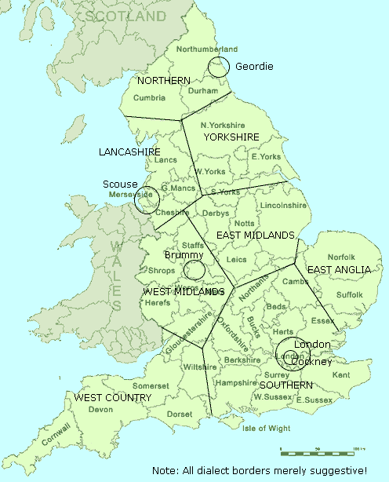
Great Britain Dialects

Slide 7
Varieties
Field of discourse
Medium
Attitude
Depends on our attitude to the hearer(reader), to the topic, to the purpose of our communication
Type of activity engaged in though language
spoken
written
Lexical item
Used a lot expressions and signs to be understood
Are used many devices to transmit the language
Law, cookery, engineering, football
formal
informal
Stress, rhythm, intonation, tempo

