Slide 1
The Origin of the English Language

Slide 2
THE LINGUISTIC GEOGRAPHY
OF EUROPE
WESTERN EUROPE
Celtic-speaking south
Germanic-speaking north
Disappeared as spoken language
Latin
Africa, south Germany and Britain
Modern German
British
Celtic
Irish
Celtic
Roman Empire
Survived
Central areas of continental Europe
Italy, Spain, Portugal, most of Britain, Germany south, north Africa and Palestine
Mixture of dialects spoken in south of Denmark
Britain
Gaelic
Romance languages
Dutch
And Flemish
Frisian Dialects
English

Slide 3
LANGUAGE CONTACT
IN EUROPE
Contact between tribal groups
Roman people
Germanic people
Language change
Trade and military contact

Slide 4
LANGUAGE
IN BRITAIN
Early language spoken in Britain
Welsh
Celtic language
Irish
Scots Gaelic
4th Celtic
period
Britain and Ireland
Pretanic islands
Welsh→ prydain
Romans→ Britannia
English name → Britain

Slide 5
English language
Celtics
Romans
Angles, Saxons and Jutes
1th inhabitants
Germanic migrants crossed the north sea and settled in Britain
Roman invasion of Britain by Julius Caesar.
East and also south of Midland
South part of Britain
Angles→ Central Denmark
Saxons→ Southern Germanic
Between the Jutes and the Angles
Jutes→ northern of Denmark
Settled mainly in Kent
Northumbria
Different dialects
Mercia
West Saxons
Kentish

Slide 6
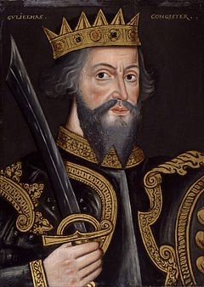
ENGLISH LANGUAGE
Vikings
Normans
Norway and Denmark
William the Conqueror invades and conquers England.
Settled : northern part of Britain
1066 Battle of Hasting

Slide 7
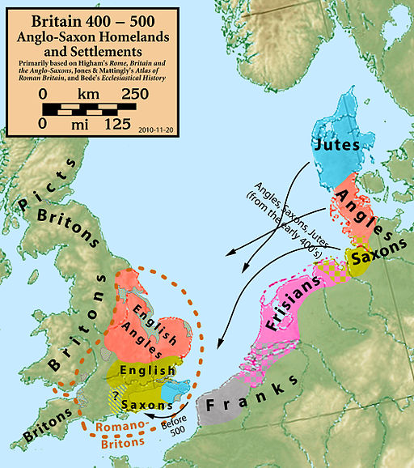
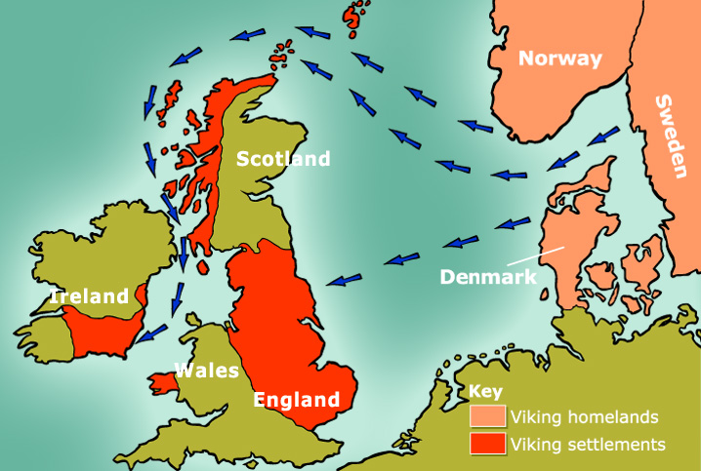
Anglo-Saxons`invasion
Viking invasion

Slide 8
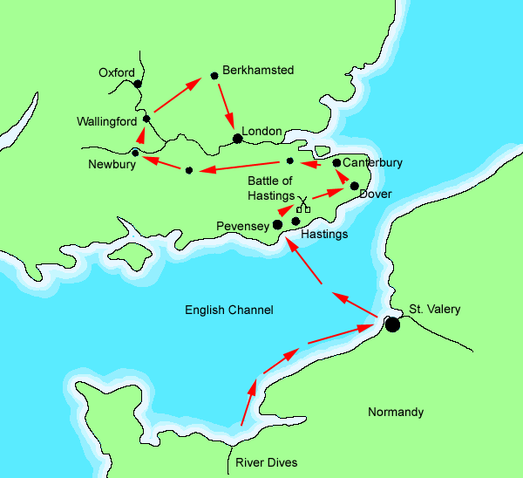
Norman Invasion

Slide 9
Spoken language
Written Language
Interacting with Latin as the international language of Christendom
Interacting with Celtic in the context of the emerging kingdoms
Christianity
introduce
Anglo- Saxons
Latin
Latin literacy controlled by the church
From the beginning wit tern English reflect the power of the church
First English texts were produced in Northumbria
Written English
Influences on old English
2nd century
Germanic tribes
Runes alphabets

Slide 10
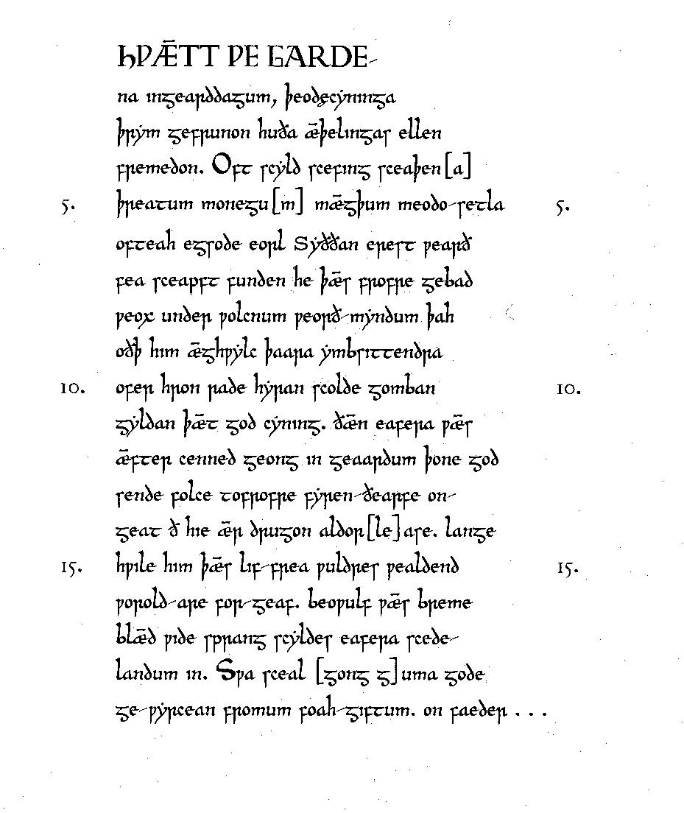
Old English Epic poem

Slide 11
THE SURVIVAL OF CELTIC
Anglo-Saxons settled in Eastern of England
Celts speakers learn English
Celts
Native population
Northumbria, Mercia and Wessex adopted English
Old English continued to be spoken to the north and west, highlands , south-west Scotland , Wales, Cornwall
Spoken in Cumberland
Wealas
Language: Welsh
Adopted English
Survived in Wallasey
Picts
Over-run by Gaelic-speaking tribe
Dominant language of the highlands
Scots

Slide 12
British people
Changed
Anglo-Saxons
Language
Society
Over controlled old Celtic Kingdoms
Military conquest
Sounds
Culture
Local population began to speak English
Continued to the present day
Grammar
Vocabulary

